Slide 1
DTS207TC Database Development and Design
Lecture 5 Web
Chap 8.2 OR-Mapping
Chap 9 App. Development
Di Zhang, Autumn 2025
Notes:
I am very happy to have the opportunity to meet with you all in this course.

Slide 2
Outline
Web Architecture
HTML
Web Server
ORM

Slide 3
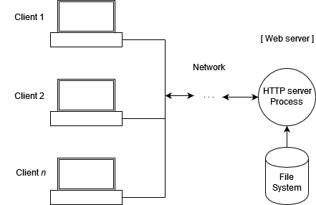
Overview
A web server is computer software and underlying hardware that accepts requests via HTTP (the network protocol created to distribute web content).
A user agent, commonly a web browser or web crawler, initiates communication by making a request for a web page or other resource using HTTP, and the server responds with the content of that resource or an error message.
A web server can also accept and store resources sent from the user agent if configured to do so.

Slide 4
Web Server
A Web server can be a physical computer that provides and hosts website content,or it can be a software program that controls network users'access to files.It receives requests from clients such as browsers via the HTTP(or HTTPS)protocol,looks up and returns the requested web pages,images,videos,and other content.
Two Meanings of Web Server
Hardware(Physical Machine):A computer connected to the Internet that stores all the files of a website,such as HTML files,CSS style sheets,JavaScript files,and images.
Software:A program running on the hardware,with the most important part being the HTTP server.It is responsible for processing HTTP requests from clients and sending the corresponding website content back in the form of HTTP responses.

Slide 5

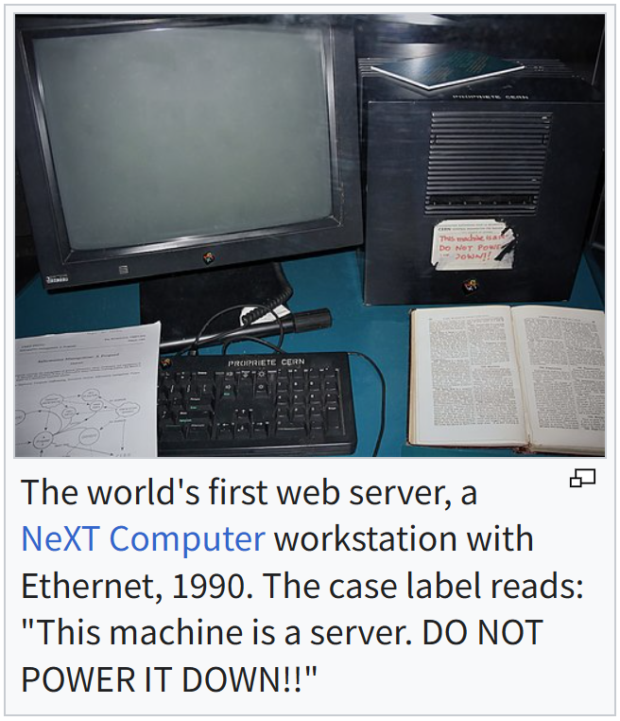
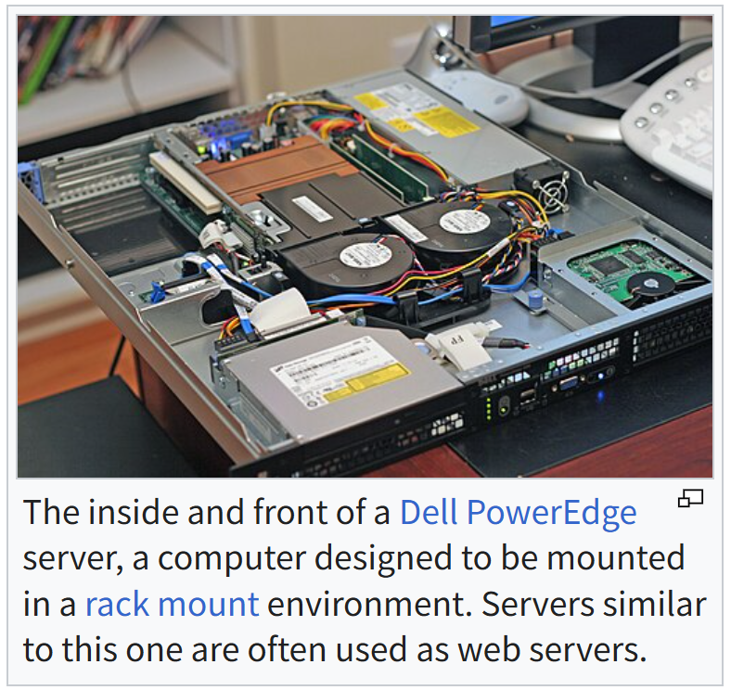
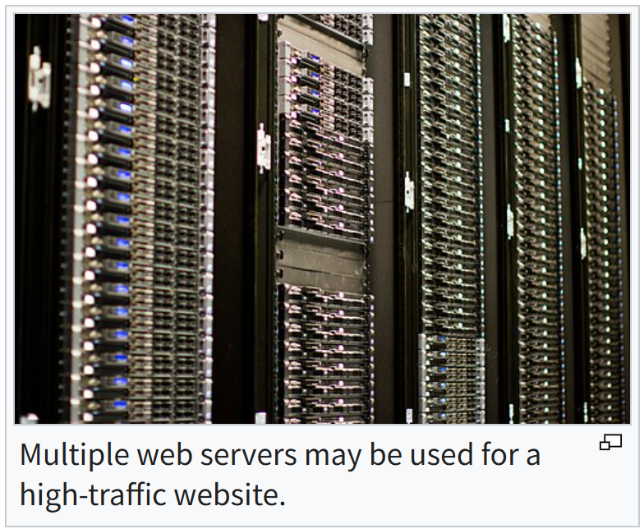
*Hardware
The hardware used to run a web server can vary according to the volume of requests that it needs to handle. At the low end of the range are embedded systems, such as a router that runs a small web server as its configuration interface. A high-traffic Internet website might handle requests with hundreds of servers that run on racks of high-speed computers.

Slide 6
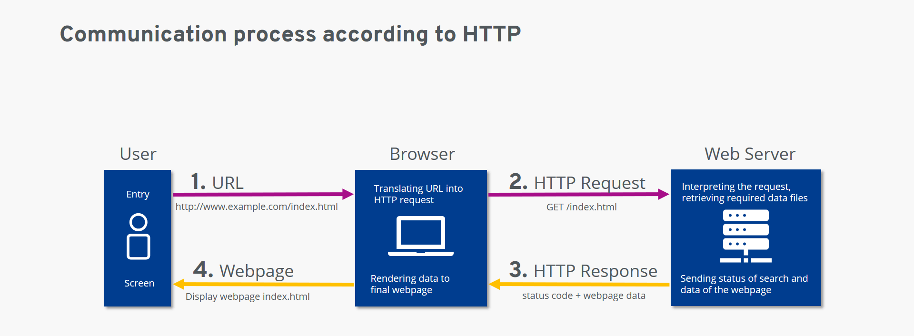
Working Principle
Request:When you type a URL into your browser,the browser sends an HTTP request to the Web server corresponding to that website.
Processing:After receiving the request,the Web server identifies the URL and looks for the relevant web page files.
Response:The Web server sends the found web page content(such as HTML,images,etc.)as a response back to the browser via the HTTP protocol.
Display:After receiving the response,the browser parses and displays the content to you,ultimately showing you the web page.

Slide 7
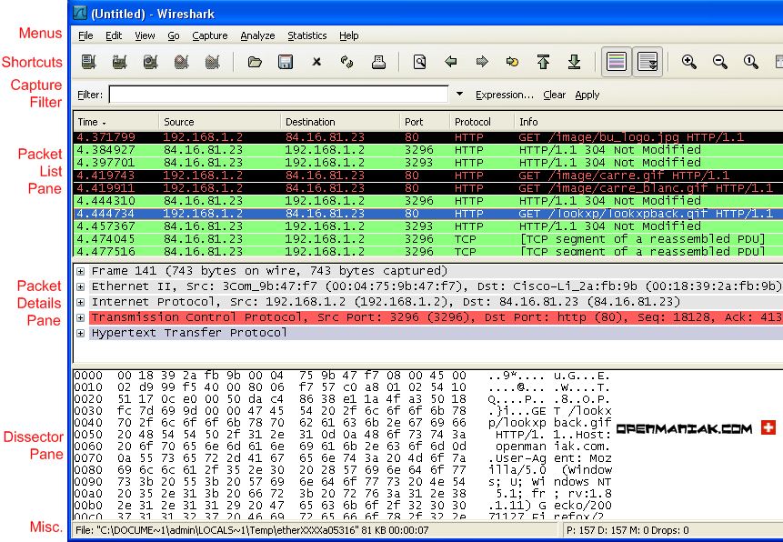

Slide 8
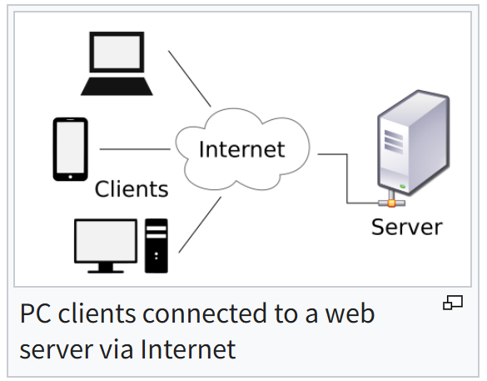
Software
A web server program plays the role of a server in a client–server model by implementing one or more versions of HTTP protocol, often including the HTTPS secure variant and other features and extensions that are considered useful for its planned usage.

Slide 9
Examples

Slide 10
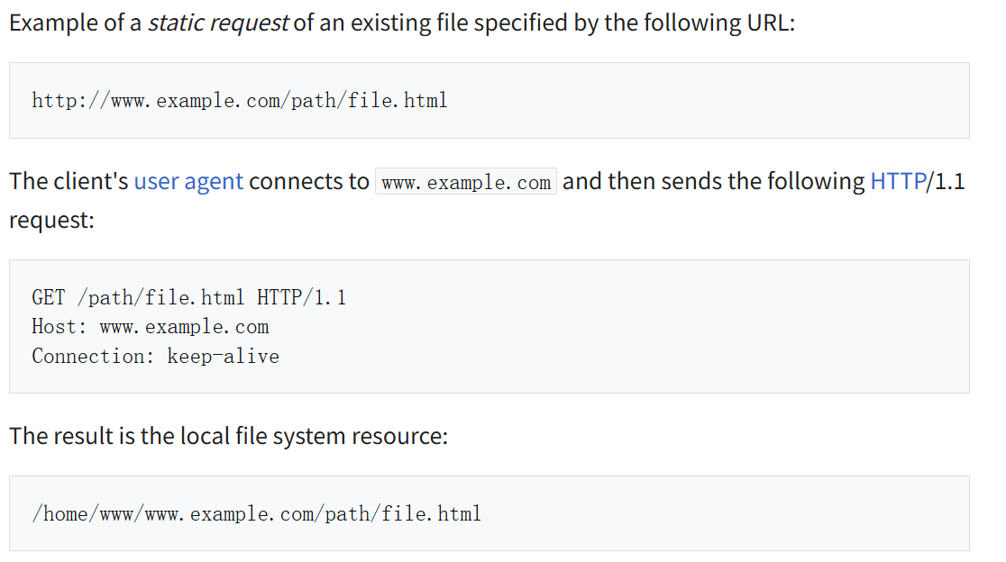
Static content serving
Static content serving: to be able to serve static content (web files) to clients via HTTP protocol.

Slide 11
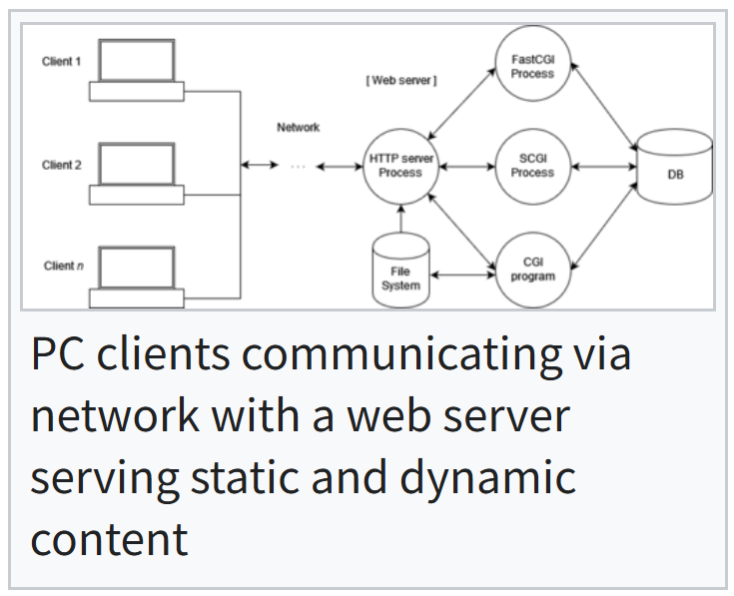
Dynamic content serving
Dynamic content serving: to be able to serve dynamic content (generated on the fly) to clients via HTTP protocol.

Slide 12
Layers
Web Pages
HTML
Business Logic
Python
ORM
Python
Database
SQL

Slide 13
Application Programs and User Interfaces
Most database users do not use a query language like SQL
An application program acts as the intermediary between users and the database
Applications split into
front-end
middle layer
backend
Front-end: user interface
Forms
Graphical user interfaces
Many interfaces are Web-based

Slide 14
Application Architecture Evolution
Three distinct era’s of application architecture
Mainframe (1960’s and 70’s)
Personal computer era (1980’s)
Web era (mid 1990’s onwards)
Web and Smartphone era (2010 onwards)

Slide 15
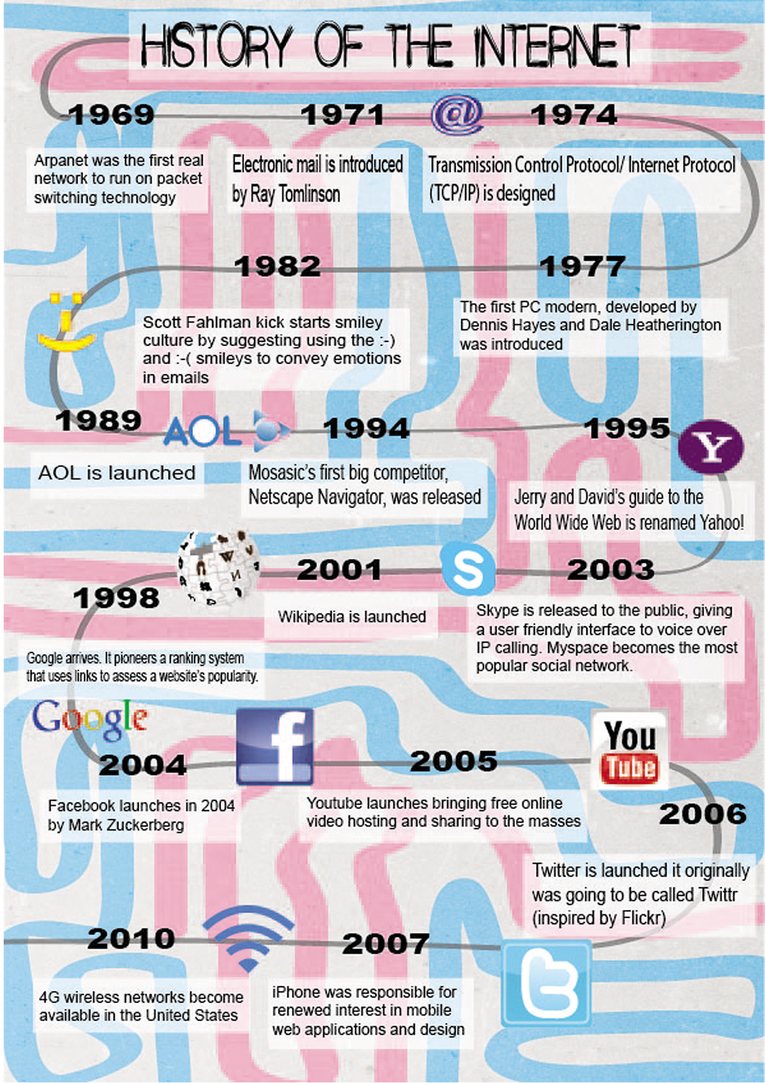


Slide 16
Web Interface
Web browsers have become the de-facto standard user interface to databases
Enable large numbers of users to access databases from anywhere
Avoid the need for downloading/installing specialized code, while providing a good graphical user interface
Javascript, Flash and other scripting languages run in browser, but are downloaded transparently
Examples: banks, airline and rental car reservations, university course registration and grading, an so on.

Slide 17
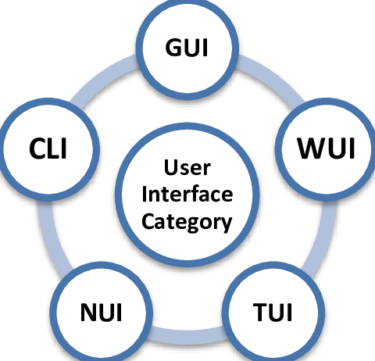
*Type
Notes:
NUI：Natural user interface
TUI: Textual user interface

Slide 18

The World Wide Web
The Web is a distributed information system based on hypertext.
Most Web documents are hypertext documents formatted via the HyperText Markup Language (HTML)
HTML documents contain
text along with font specifications, and other formatting instructions
hypertext links to other documents, which can be associated with regions of the text.
forms, enabling users to enter data which can then be sent back to the Web server

Slide 19

Uniform Resources Locators
In the Web, functionality of pointers is provided by Uniform Resource Locators (URLs).
URL example:
http://www.acm.org/sigmod
The first part indicates how the document is to be accessed
“http” indicates that the document is to be accessed using the Hyper Text Transfer Protocol.
The second part gives the unique name of a machine on the Internet.
The rest of the URL identifies the document within the machine.
The local identification can be:
The path name of a file on the machine, or
An identifier (path name) of a program, plus arguments to be passed to the program
E.g., http://www.google.com/search?q=silberschatz
Ping

Slide 20
HTML and HTTP
HTML provides formatting, hypertext link, and image display features
including tables, stylesheets (to alter default formatting), etc.
HTML also provides input features
Select from a set of options
Pop-up menus, radio buttons, check lists
Enter values
Text boxes
Filled in input sent back to the server, to be acted upon by an executable at the server
HyperText Transfer Protocol (HTTP) used for communication with the Web server

Slide 21
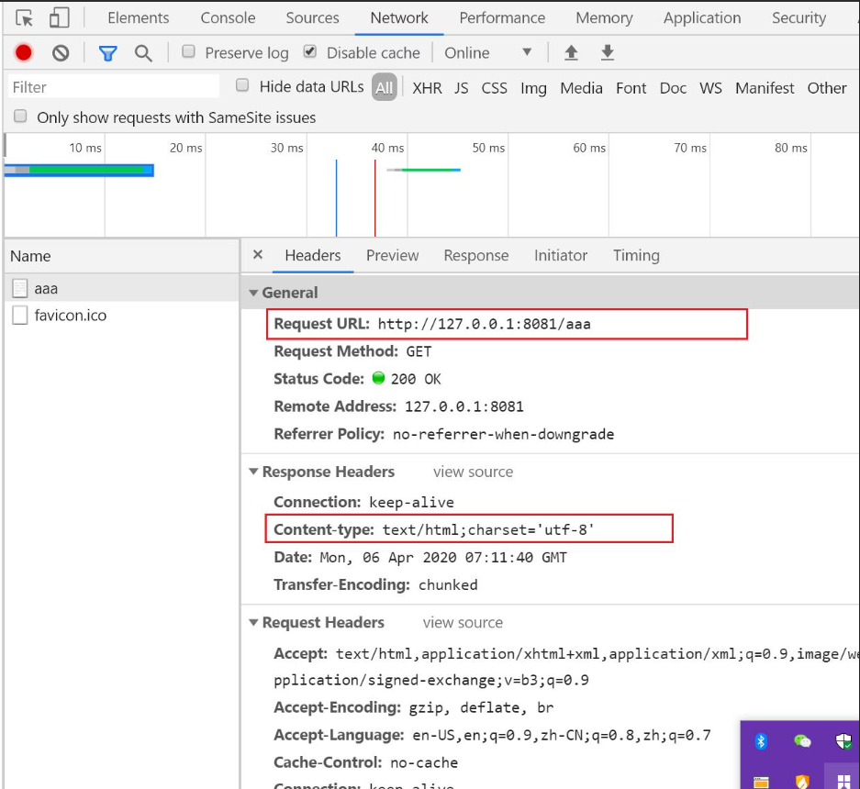
HTTP Header

Slide 22

Sample HTML Source Text
<html>
<body>
<table border> <tr> <th>ID</th> <th>Name</th> <th>Department</th> </tr> <tr> <td>00128</td> <td>Zhang</td> <td>Comp. Sci.</td> </tr> ….
</table>
<form action="PersonQuery" method=get> Search for: <select name="persontype"> <option value="student" selected>Student </option> <option value="instructor"> Instructor </option> </select> <br> Name: <input type=text size=20 name="name"> <input type=submit value="submit">
</form>
</body> </html>
5~11

Slide 23
Display of Sample HTML Source

Slide 24
Javascript
What is JavaScript?
Client-side scripting language – runs in the browser
Dynamic interaction – makes web pages interactive
Cross-platform – supported by all modern browsers
Core Features
Lightweight interpreted language
Supports object-oriented programming
Seamless integration with HTML/CSS
Rich ecosystem and libraries
Main Applications
Front-end web development
Server-side development (Node.js)
Mobile app development
Game development
This Will be taught in Lab5!

Slide 25
Web Servers
A Web server can easily serve as a front end to a variety of information services.
The document name in a URL may identify an executable program, that, when run, generates a HTML document.
When an HTTP server receives a request for such a document, it executes the program, and sends back the HTML document that is generated.
The Web client can pass extra arguments with the name of the document.
To install a new service on the Web, one simply needs to create and install an executable that provides that service.
The Web browser provides a graphical user interface to the information service.

Slide 26
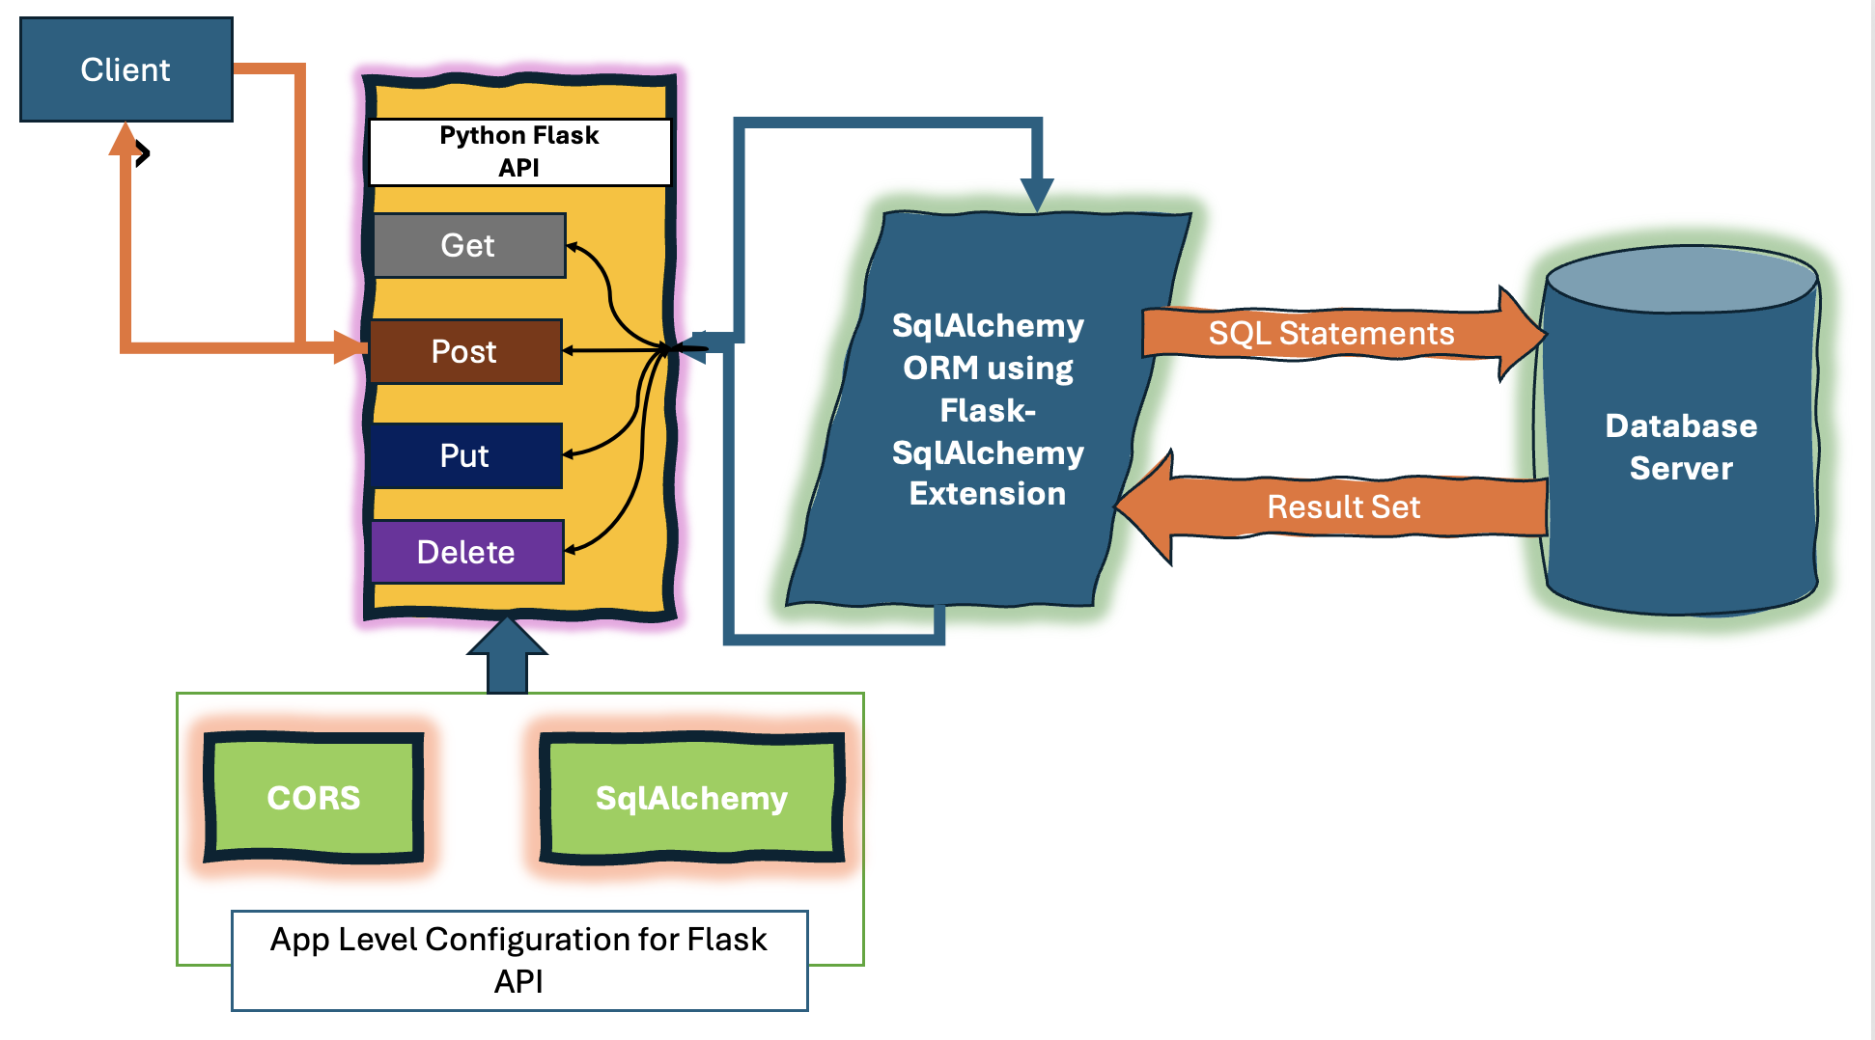
Flask
Flask is a lightweight Python web framework ideal for building small to medium-sized web applications.
12

Slide 27
Routing
Modern web applications use meaningful URLs to help users. Users are more likely to like a page and come back if the page uses a meaningful URL they can remember and use to directly visit a page.
13

Slide 28
Variable Rule
You can add variable sections to a URL. Your function then receives the as a keyword argument.
14

Slide 29
Rendering Templates
Generating HTML from within Python is not fun, and actually pretty cumbersome because you have to do the HTML escaping on your own to keep the application secure.
Templates can be used to generate any type of text file. For web applications, you’ll primarily be generating HTML pages, but you can also generate markdown, plain text for emails, and anything else.
15

Slide 30
Receiving User Inputs
Get Method
GET is a request method in the HTTP protocol used to request access to a specific resource on a server. It is one of the most commonly used HTTP request methods, primarily used to retrieve data from a server.
Parameters are passed in the URL, which reduces security and imposes a request length limit.
Post Method
POST is also a request method in the HTTP protocol used to submit data to a server to create or update resources. It is commonly used for operations such as submitting form data and uploading files.
Parameters are passed in the request body, which provides increased security and an unlimited request length.
16

Slide 31
Object-oriented Programming
Object-oriented programming (OOP) is a programming paradigm based on the object – a software entity that encapsulates data and function(s).
An OOP computer program consists of objects that interact with one another.
Main features: Encapsulation, Inheritance, and Polymorphism
1

Slide 32
Object Orientation
Object-relational data model provides richer type system
with complex data types and object orientation
Applications are often written in object-oriented programming languages
Type system does not match relational type system
Switching between imperative language and SQL is troublesome
Approaches for integrating object-orientation with databases
Build an object-relational database, adding object-oriented features to a relational database
Automatically convert data between programming language model and relational model; data conversion specified by object-relational mapping
Build an object-oriented database that natively supports object-oriented data and direct access from programming language

Slide 33
Object-Relational Mapping
Object-relational mapping (ORM) systems allow
Specification of mapping between programming language objects and database tuples
Automatic creation of database tuples upon creation of objects
Automatic update/delete of database tuples when objects are update/deleted
Interface to retrieve objects satisfying specified conditions
Tuples in database are queried, and object created from the tuples
Details in Section 9.6.2
Hibernate ORM for Java
Django ORM for Python

Slide 34
Object-Relational Database Systems
User-defined types
create type Person (ID varchar(20) primary key, name varchar(20), address varchar(20)) ref from(ID); /* More on this later */ create table people of Person;
Table types
create type interest as table ( topic varchar(20), degree_of_interest int); create table users ( ID varchar(20), name varchar(20), interests interest);
2

Slide 35
Type and Table Inheritance
Type inheritance
create type Student under Person (degree varchar(20)) ; create type Teacher under Person (salary integer);
Table inheritance syntax in PostgreSQL and oracle
create table students (degree varchar(20)) inherits people; create table teachers (salary integer) inherits people;
create table people of Person; create table students of Student under people; create table teachers of Teacher under people;
3

Slide 36
Reference Types
Creating reference types
create type Person (ID varchar(20) primary key, name varchar(20), address varchar(20)) ref from(ID); create table people of Person; create type Department ( dept_name varchar(20), head ref(Person) scope people); create table departments of Department insert into departments values ('CS', '12345’)
System generated references can be retrieved using subqueries
(select ref(p) from people as p where ID = '12345')
Using references in path expressions
select head->name, head->address from departments;
4

Slide 37
Integration
A simple web application
17

Slide 38
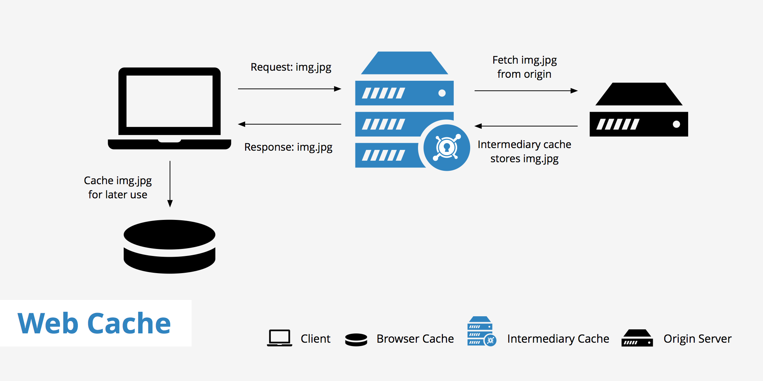
Performance

Slide 39
*Web Services
Allow data on Web to be accessed using remote procedure call mechanism
Two approaches are widely used
Representation State Transfer (REST): allows use of standard HTTP request to a URL to execute a request and return data
Returned data is encoded in XML
Big Web Services:
Uses XML representation for sending request data, as well as for returning results
Standard protocol layer built on top of HTTP
See Section 23.7.3
18

